Slide 1
______________________________________________
EXPORT MARKETING AND INVESTMENT ASSISTANCE
(EMIA)
Competitiveness Incentive Cluster
Industrial Finance Division (IFD)
Competitiveness Incentive Cluster (CIC)
18 August 2021
Export Awareness Workshop

Slide 2
EXPORT MARKETING AND INVESTMENT ASSISTANCE (EMIA)
EMIA develops export markets for South African products and services, and recruits new foreign direct investment into the country

Slide 3
OBJECTIVES
Provide marketing assistance to develop new and grow existing export markets;
Assist with the identification of new export markets through market research;
Assist companies to increase their competitiveness by supporting patent registrations, quality marks and product marks;
Assist with facilitation to grow foreign direct investment (FDI) through missions and FDI research;
Increase the participation of black owned businesses and SMME’S to SA economy

Slide 4
EMIA OFFERINGS
Individual Participation | Project Funding
Individual Exhibitions | Sector Specific Assistance Scheme
Foreign Direct Investment and Primary Market Research | Capital Projects Feasibility Programme
Individual Inward Missions

Slide 5
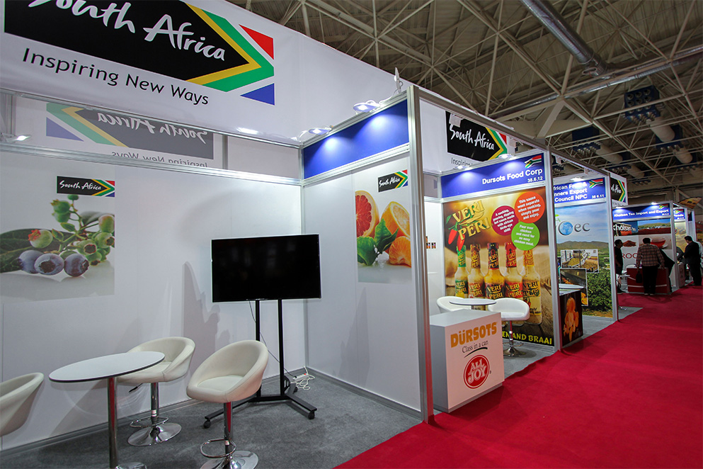
INDIVIDUAL PARTICIPATION

Slide 6
INDIVIDUAL PARTICIPATION
Individual Exhibitions
Assistance is granted to individual exporters to exhibit products and services at recognised exhibitions abroad where TISA does not provide for a national pavilion
Primary Market Research & Foreign Direct Investment
Assistance is provided to partially compensate exporters for costs incurred in developing new export markets and to recruit new foreign direct investment into S.A through personal contact by visiting potential investors in foreign countries

Slide 7
INDIVIDUAL PARTICIPATION continued
Assistance under PMR is also extended towards attending the following:
Exhibition linked to Market research
Conference (Speaker)
Registration of patents, trade marks & quality marks
Assistance is provided to exporters for costs incurred relating to registration of a product in a foreign market

Slide 8
ACTUAL ASSISTANCE
Assistance is provided on the following basis:
Travel (economy class)
Daily subsistence
Transport of samples
Designing and printing of marketing materials
Exhibition costs relating to stand rental, stand design and set up costs; rental of furniture

Slide 9
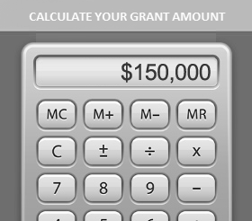
INDIVIDUAL PARTICIPATION ASSISTANCE
Economy class return airfare
HDI’s & SMME’s | 100% to Maximum of R17,000
Subsistence Allowance
HDI’s & SMME’s | R2,300 per day
Transport of Samples
HDI’s, SMME’s | R17,500
Exhibition costs
HDI’s SMME’s and Other size | R50 000 in countries outside the African Continent. R75 000 inside the African Continent Included: Design and printing of marketing materials, maximum R7000 (Excluding VAT)

Slide 10
PRIMARY MARKET RESEARCH ASSISTANCE
Economy class return airfare
HDI’s & SMME’s | 100% to Maximum of R17,000
Subsistence Allowance
HDI’s & SMME’s | R2,300 per day
Transport of Samples
HDI’s, SMME’s | R1,000
Registration of a product in a foreign market
HDI’s SMME’s and Other size | Such as international patent and quality market registration. Only invoices dated six months prior and twelve months after the date of approval will be considered for reimbursement. 50% of the actual costs to a maximum of R 100 0000

Slide 11
EMIA GENERIC DOCUMENTS
1. | Export Registration Certificate (SARS)
2. | Certificate of Incorporation (CIPC)
3. | Comprehensive colour brochure or Devices
4. | Latest Audited or Independently reviewed/compiled Financial Statements
5. | Export Marketing Plan
6. | B-BBEE certificate of compliance level 1-8 or affidavit for EME’s or QSE’s

Slide 12
EMIA DOCUMENTS
7. | Three Air Ticket quotations from three service providers
8. | Three Freight quotations from three service providers
9. | Three quotations for the design and printing of marketing materials
10. | Commission Agents, copies of agency agreements from three SMME’s or HDI’s to be presented at the event.
11. | Export Trading House, letters confirming permission to represent three SMME’s or HDI’s
12. | Outsource Agreements for entities outsourcing their manufacturing process

Slide 13
EMIA DOCUMENTS
13. | Electronic email or confirmation letters from businesses abroad on the company letterhead confirming two scheduled appointments must be submitted to EMIA at least 14 days prior to the date of departure
14. | A detailed confirmed itinerary of companies to be visited (names, address of companies to be visited and contact details)
15. | A copy of the conference programme. Clearly indicating the nature and the status of the conference, speakers, main and sub-themes must be submitted with the application. The attendee should be the speaker in the conference

Slide 14
MANDATORY CONDITIONS
All entities should have traded for more than one financial year.
The entity must be a registered legal entity in South Africa in terms of the Companies Act, 1973 (as amended), or the Close Corporations Act, 1984 (as amended) or Co-operatives Act, 1981 (as amended) except in case of a sole proprietor and partnerships.
The applicant must be a taxpayer in good standing and provide a valid tax clearance certificate before EMIA incentive is disbursed.
Completed applications should reach the dtic two months /six months before the commencement date of the event.
Entities applying for EMIA financial assistance are subjected to a site visit.

Slide 15
ELIGIBLE ENTERPRISES
South African manufacturers and exporters.
South African export trading houses representing at least three SMMEs or businesses owned by historically disadvantaged individuals (HDIs).
South African commission agents representing at least three SMMEs/HDI-owned businesses.
South African exports councils, industry associations and Joint Action Groups representing at least five South African entities.

Slide 16
PMR QUALIFYING CRITERIA
Compensation under PMR will be confined to market research aimed at the establishment of new markets and not further development for a particular product in a specific country. No follow-up visit is allowed
A minimum of two confirmed appointments per day must be scheduled to qualify for a subsistence allowance.
Entities may attend a relevant exhibition under PMR in the same market. This assistance is limited to two (2) days towards attending an exhibition.
These appointment should be scheduled outside the exhibition.
Assistance is extended towards attending conferences with the aim of lobbying for international projects or hosting international events.

Slide 17
LIMITATIONS
Individual Participation (Individual Exhibitions, Primary Market Research & Foreign Direct Investment and Individual Inward bound missions of assistance is limited to four (4) applications per calendar year
EMIA incentives are not available for events taking place in the period 10 December up to and including 10 January of each year

Slide 18
LIMITATIONS ( Continued)
Participation in countries , which are members of the South African Customs Union ( Botswana, Lesotho, Swaziland and Namibia) are excluded from EMIA Assistance.

Slide 19
APPLICATION PROCESS
STEP 1
STEP 2
STEP 3
STEP 4
Submit the application via email and by courier/hand deliver
Allocation of the application, review and ready for presentation
Go through EMIA Guidelines
Technical evaluation and adjudication of the application
dtic Campus/
emia@thedtic.gov.za
The dtic official
Adjudication committee
Via: www.thedtic.gov.za

Slide 20
CLAIMS PROCESS
STEP 1
STEP 2
STEP 3
STEP 4
Submit the claim form and approval letter 3 months from the end date
Technical Evaluation of claim
Go through EMIA Guidelines
Payment Process
Via: hand delivered of Courier
dtic Campus
The dtic EMIA officials
The dtic Finance Division

Slide 21
REASONS FOR DECLINE
Entity not in operation for a year.
Incomplete applications: Applicant is provided with 5 working days to submit outstanding documents, documents not received within this period.
Late applications: Not submitted at least two months before the event start date.
Insufficient information regarding the nature, profile, size and international status of the event.
Participation at private exhibitions.

Slide 22
REASONS FOR DECLINE
Exceeding the number of assistance per calendar year, not informing EMIA if participation is cancelled and therefore exceeding maximum
Exhibition programme not submitted if the exhibition form part of conference or congress
Local content less than 35%
Events within the exclusion period
Non B-BBEE Compliant

Slide 23
REASONS FOR DECLINE
Air ticket quotes, screen shots from internet without listing website addresses
Invalid quotes or not verifiable (Air ticket, Transport of samples and Marketing material)
Incomplete work itinerary and letters of confirmation for PMR
Exhibition at a conference, inclusion of an exhibition programme indicating the Exhibition hours.
If applying PMR speaker, official conference programme indicating the speaker.

Slide 24
ADDITIONAL INFORMATION/ CLARITY
Reason for sudden decline or increase in turnover
Export capacity value not in relation to turnover - explanation
Export sales not aligned to turnover
Return on investment as a result of previous assistance
Growth trend analysis
In compliance with relevant statutory regulations and must meet the minimum environmental standards, health and safety regulations.

Slide 25
ADDITIONAL INFORMATION / CLARITY
Reason for previous cancellations and no claims
Outsource Agreement specify should be signed, dated and stipulate the expiry date
Insufficient contact details in order to validate quotations

Slide 26
Notice Individual Participation
Due to the fluid global Covid-19 travel implications and country specific restrictions, new applications for physical international and inbound EMIA IP exhibitions are still not considered and until further notice. New applications for EMIA IP product and or patent certification applications which have no international travel implications for qualifying exporters, may however now be submitted to the dtic. This position will be reviewed subject to further announcements on Covid-19 travel restrictions. Anouncements for the introduction of support for virtual exhibitions, that do not require international travel, will however be announced soon.

Slide 27
CONTACT DETAILS
Industrial Finance Division (IFD): EMIA MANAGERS
Director: EMIA | Sithembile Tantsi | stantsi@thedtic.gov.za | 012 394 1258
Deputy Director: Applications | Busisiwe Radebe | BRadebe@thedtic.gov.za | 012 394 1038
Deputy Director Claims | Simon Rabekane | SRabekane@thedtic.gov.za | 012 394 1449

Slide 28
CONTACT DETAILS
Industrial Finance Division (IFD): EMIA Officials
Assistant Director: Application | Khabo Mhlanga | KMhlanga@thedtic.gov.za | 012 394 1349
Assistant Director: Applications | Judy Snyman | JSnyman@thedtic.gov.za | 012 394 1035
Trade & Industry Advisor: Applications | Samuel Tsheko Modise | STModise@thedtic.gov.za | 012 394 1651

Slide 29
CONTACT DETAILS
EMIA: IFD CUSTOMER SERVICE APPLICATIONS & CLAIMS
CUSTOMER RELATIONS REPRESENTATIVE | PUMZO SIVE TSHIKITSHWA | PTshikitshwa@thedtic.gov.za | 012 394 1249 082 903 6129

Slide 30
Contact Centre
0861 843 384
Website
www.thedtic.gov.za

Slide 31
COURIER ADDRESS:
the dtic CAMPUS
MAPUNGUBWE
BLOCK A
UTANGAMIRI BUILDING
12 ROBERT SOBUKWE SUNNYSIDE
PRETORIA
GAUTENG
0002

Slide 32
Thank you

